Slide 1
Hack the Future:
A Gen AI Sprint Powered by Data

Slide 2

Guidelines
The template should consist of the following and it is mandated to be used by your team for submitting your innovative ideas/solutions. Follow file naming format: Arch_Team_85_Idea Name.pptx

Slide 3




Hack the Future: A Gen AI Sprint Powered by Data
Data and AI Week
Team details
TEAM NAME: Arch_Team_85
Oscar Yanez-Feijoo

Slide 4
Entry Submission Summary
Idea Title (Provide a concise and impactful title for your idea.) | VisionHireAI – Intelligent Agentic System for Smarter Hiring
Team Name | Arch_Team_85
Problem Statement | Automating job screening through AI-powered agents that read and summarize job descriptions (JDs), extract data from CVs, calculate match scores, and schedule interviews — reducing HR workload and improving recruitment efficiency.
Proposed Solution | A multi-agent AI system where each agent plays a specific role: analyzing JDs, extracting CV insights, scoring matches, shortlisting candidates, and scheduling interviews. All agents are orchestrated using Python, SQLite, and on-prem LLMs (via Ollama).

Slide 5
Problem statement you are trying to address
Manual screening of resumes and job descriptions is slow, error-prone, and biased.
HR teams spend excessive time matching candidate CVs to job descriptions, leading to inefficiencies and missed opportunities.
The goal is to automate this pipeline with intelligent agents that summarize JDs, extract CV data, calculate relevance scores, and auto-schedule interviews.

Slide 6
Proposed Solution Overview
Brief approach description or methodology used to tackle the problem
VisionHireAI uses a modular multi-agent architecture with these key components:
- JD Analyzer Agent: Extracts structured job requirements using NLP.
- CV Extractor Agent: Parses resumes to extract skills and experiences.
- Match Scorer Agent: Calculates candidate-job fit using semantic similarity.
- Shortlisting Agent: Filters top candidates based on a match threshold.
- Interview Scheduler Agent: Sends invitations and proposes meeting slots.
Agents communicate via APIs and share memory in an SQLite DB, enabling end-to-end hiring automation.

Slide 7
Technologies Used
List the key technologies, frameworks, and tools you utilized in your solution
- Python – Core backend logic for all agents
- Ollama – Lightweight, on-prem LLMs for summarization
- LangChain – Agent orchestration and memory
- SQLite – Local database for storing JD/CV data and scores
- FastAPI – Backend server for agent interactions
- Streamlit – User interface for HR use
- Email API (e.g., SMTP or SendGrid) – For interview scheduling
- scikit-learn – For basic matching models
- PyPDF2 – Optional, to read CVs in PDF format

Slide 8
Agents' interaction design
1. JD Analyzer Agent: Receives raw JD text and extracts structured fields like skills, experience, and role summary.
2. CV Extractor Agent: Parses uploaded CVs (text or PDF) and outputs candidate info: skills, experience, name, etc.
3. Match Scorer Agent: Compares extracted JD fields with CV data to calculate a percentage match score using Jaccard similarity or vector embeddings.
4. Shortlisting Agent: Applies a threshold (e.g., 80%) to select top-matching candidates.
5. Interview Scheduler Agent: Sends email invites with proposed times and updates schedules in real time.
Agents share data via an SQLite database and communicate through a central FastAPI backend.

Slide 9
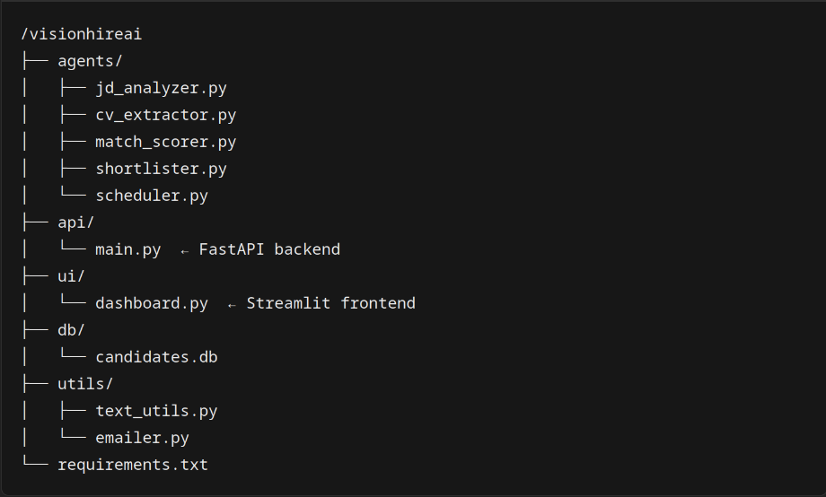
Code structure

Slide 10
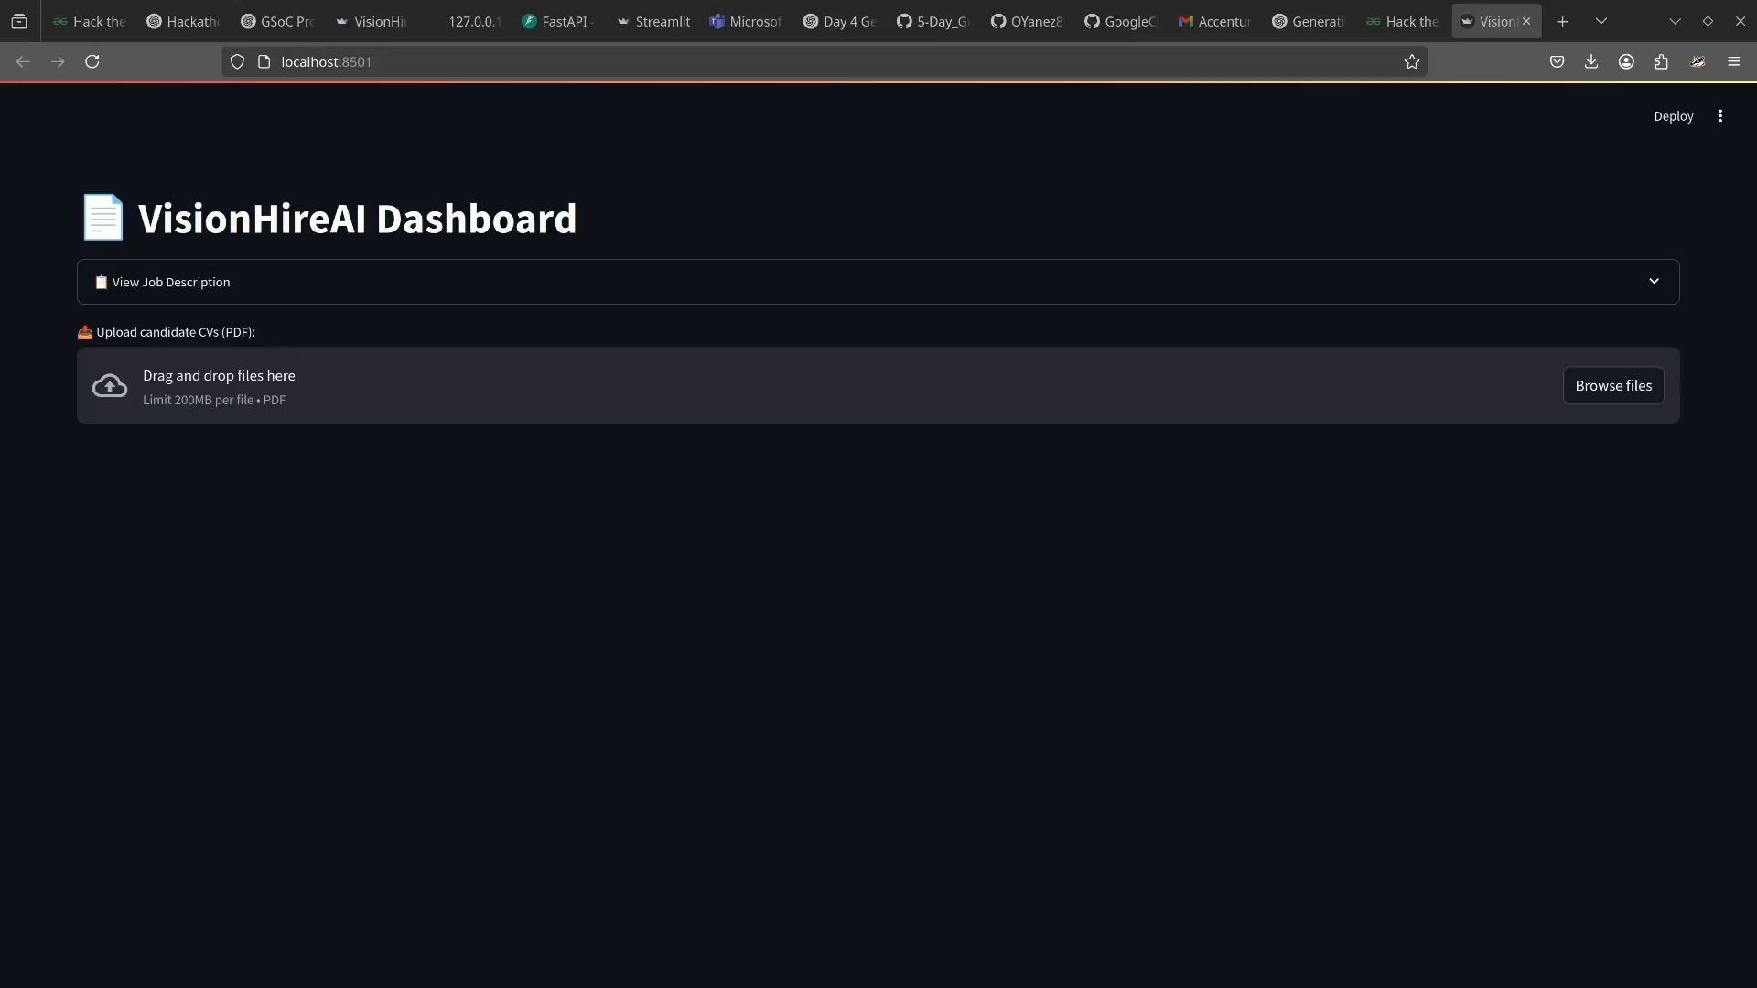
Demo video

Slide 11
Conclusion
Summarize the impact and effectiveness of your solution. Reiterate how it solves the problem statement.
VisionHireAI successfully demonstrates how a modular GenAI-powered system can streamline and automate the traditionally manual and biased process of candidate screening. By leveraging intelligent agents—each dedicated to a specific part of the recruitment pipeline—we enable scalable, accurate, and explainable candidate-job matching.
Our solution reduces manual workload for HR teams, improves consistency in candidate evaluation, and significantly shortens the time-to-hire. The combination of FastAPI and Streamlit provides a seamless backend-frontend experience, while the use of lightweight local models and tools like SQLite ensures privacy and performance.
This project showcases the potential of GenAI in real-world HR applications and lays the foundation for further enhancements like multi-role support, LLM summarization, and integration with ATS platforms.
VisionHireAI = faster hiring, fairer decisions, and smarter HR operations.

Slide 12
References/Other details
Further Enhancements
- Integration with LLMs (Gemini/OpenAI) for summarization and natural language JD matching
- Connection to Google Search or internal data for job-market enrichment
- Support for ATS import/export, interview scheduling
References
Scikit-learn TF-IDF Vectorizer: https://scikit-learn.org/stable/modules/generated/sklearn.feature_extraction.text.TfidfVectorizer.html
Streamlit (Frontend Framework): https://streamlit.io/
FastAPI (Backend Framework): https://fastapi.tiangolo.com/
PyPDF2 (PDF parsing library): https://pypi.org/project/PyPDF2/
Google Generative AI for Developers (Gemini course): https://developers.google.com/learn/pathways/generative-ai-developers

Slide 13
Thank You

